Slide 1
Revenue in staffing

Slide 2
Two approaches
Revenue from utilization
Revenue in staffing forecast

Slide 3
Revenue from utilization
Assigned
Period | Employee_id | Hours
Sep 2019 | emp_1 | 160
Sep 2019 | emp_2 | 120
Sep 2019 | emp_3 | 160
Sep 2019 | emp_4 | 150
… | … | …
Sep 2019 | emp_30000 | 135
Direct matching
Period | Position_id | hours
Sep 2019 | pos_1 | 160
Sep 2019 | pos_2 | 120
Sep 2019 | pos_3 | 160
Sep 2019 | pos_4 | 150
… | … | …
Sep 2019 | pos_30000 | 135
Not assigned
Sorting positions importance
Matching positions and employees

Slide 4
Sorting positions importance criteria
Urgency
Time to planned start date
Number of positions per project
Number of positions per customer
Time distance from created

Slide 5
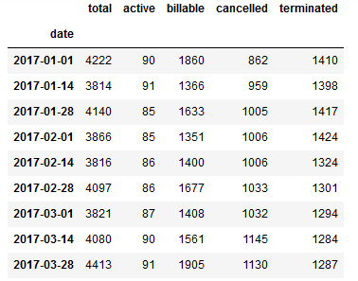
Revenue in staffing forecast

Slide 6
Set of models
Types of models:
“is_billable” model
“when_billable” model
Scope for models:
In staffing positions
Assigned positions (without reported billable hours)
No staffing required channel

Slide 7
Models quality
 | “is billable” | “when billable”
 |  | cur | next_1 | next_2 | next_+
In staffing | 76% | 77% | 76% | 41% | 66%
Assigned | 90% | 97% | 96% | 76% | 37%
No staffing required | 80% | 95% | 92% | 67% | 59%

Slide 8
Scope of positions
Is billable
Current month
Next 1 month
Next 2 month
In staffing
Next +
Current month
Next 1 month
Next 2 month
Assigned
Next +
Current month
Next 1 month
Next 2 month
No staffing required
Next +

